Slide 1

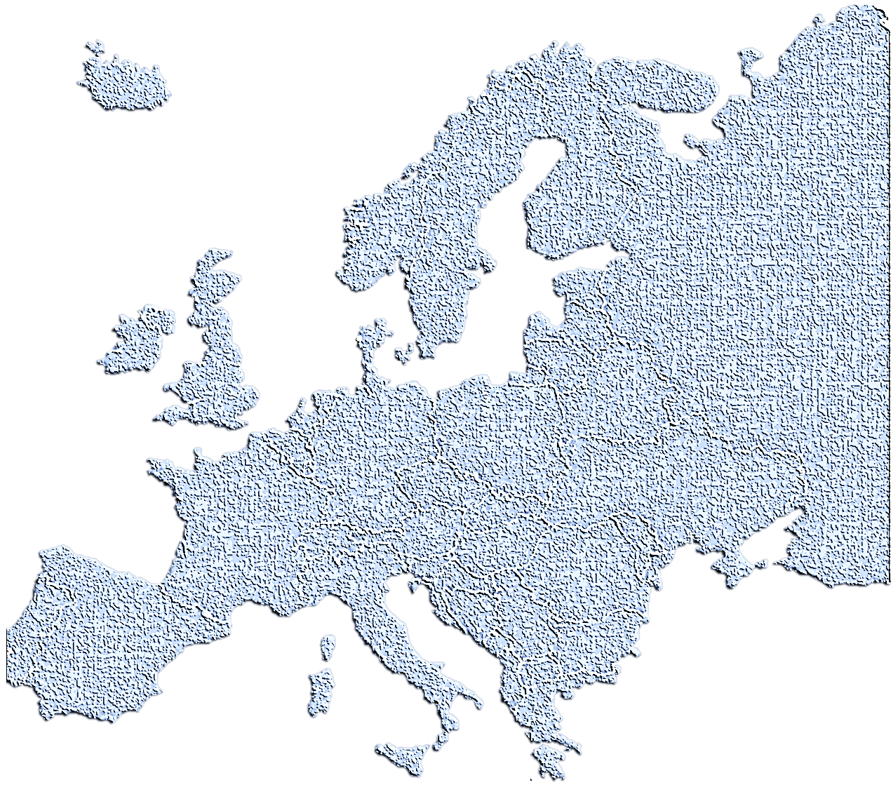

BIO727P
Bioinformatics
Software Development Group Project
SNPEuro
Team Liam
Vi Bui, Uppy Gill, Liam Johnson & Neha Khairnar

Slide 2
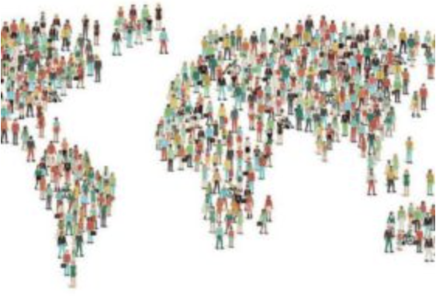
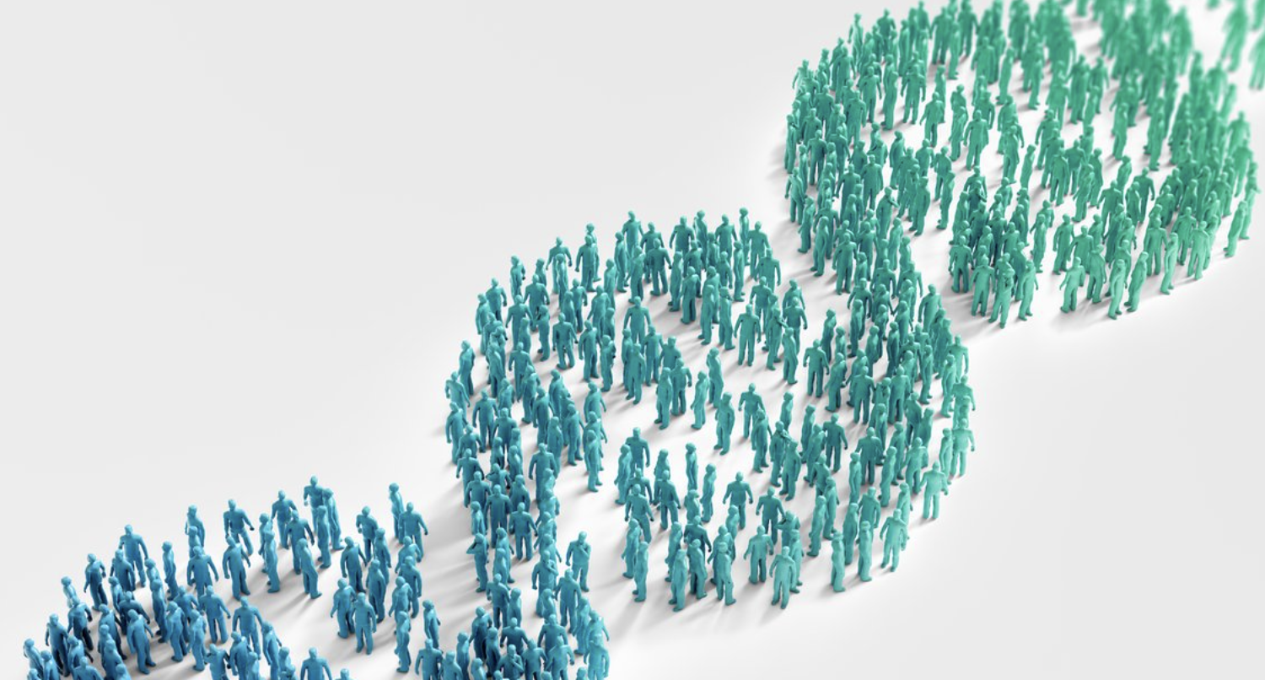
Population Genomics
Application of ‘genomic technologies’ to understand populations of organisms
In humans – facilitates how genes (SNPs & alleles) contribute to health & disease risk
Insights for medical intervention on the population frequency of a disease
Phenotypic traits promoting species response to environmental change
SNPEuro Portal
Notes:
Intro

Slide 3
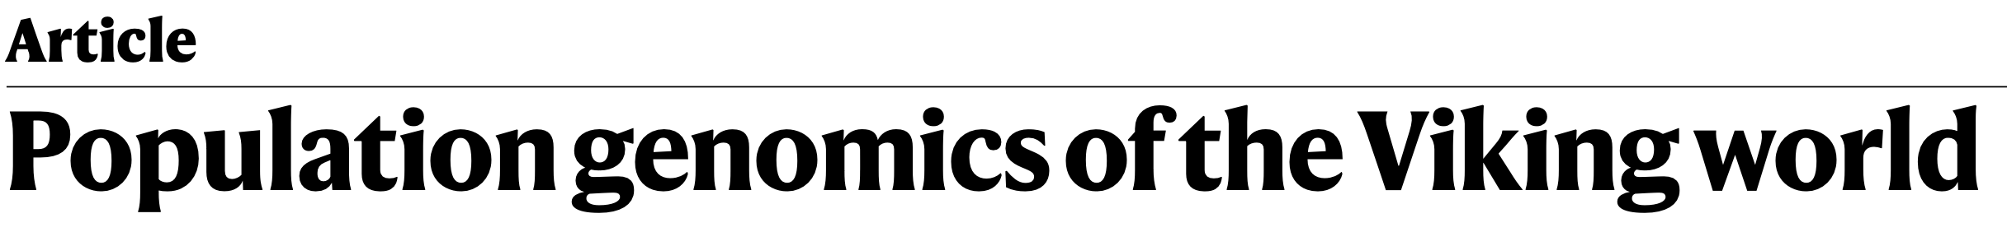
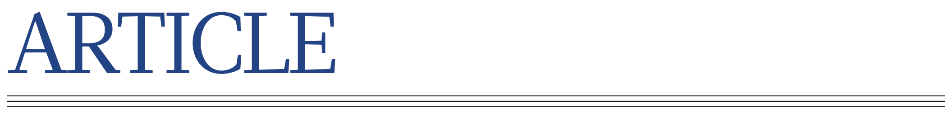
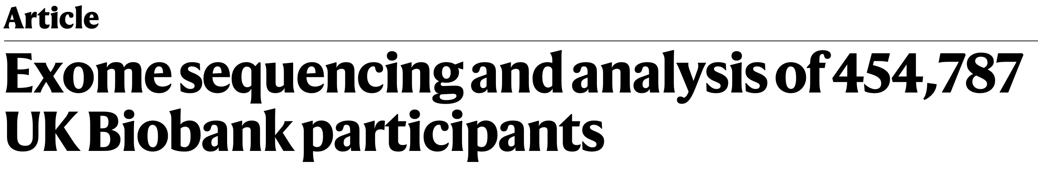
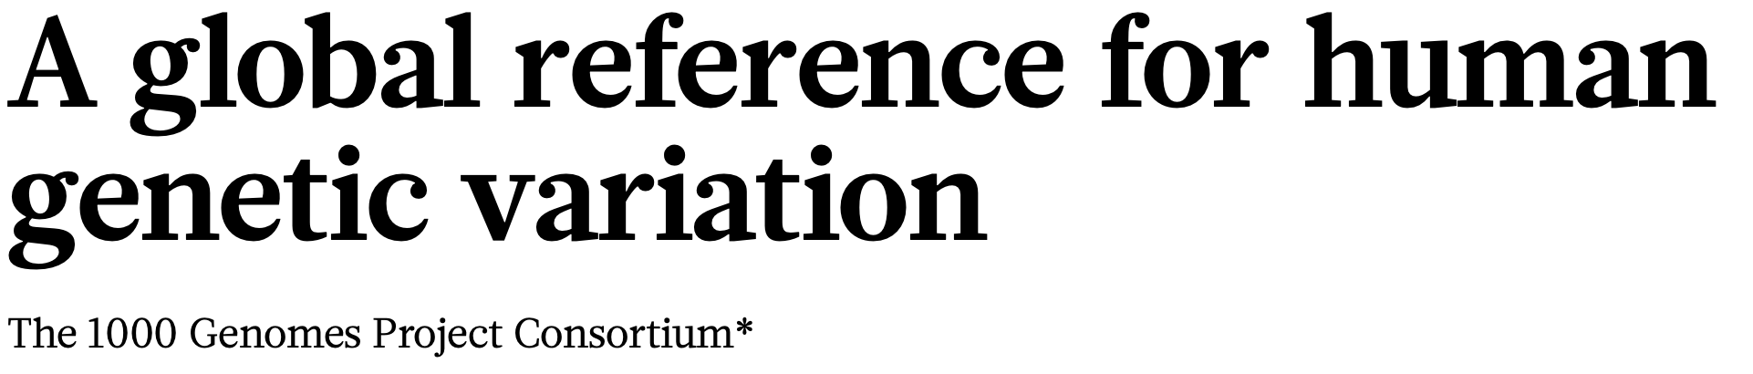
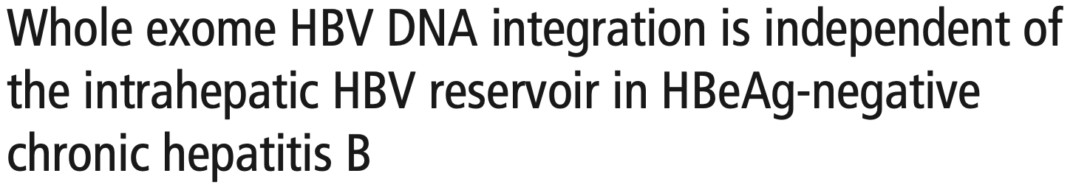
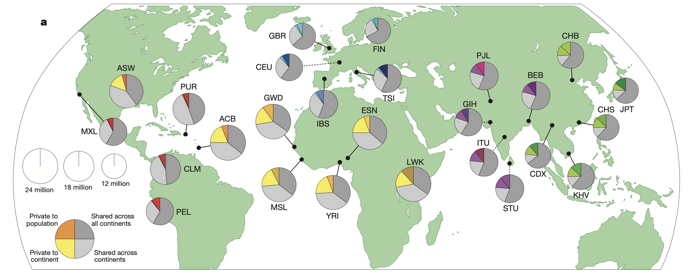
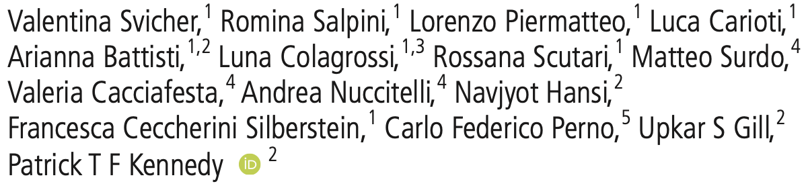


Population Genomics
Study of genetic composition of populations, distribution & change in;
genotype & phenotype frequency in relation to natural selection, genetic drift, mutation & gene flow
SNPEuro Portal
Notes:
Intro

Slide 4
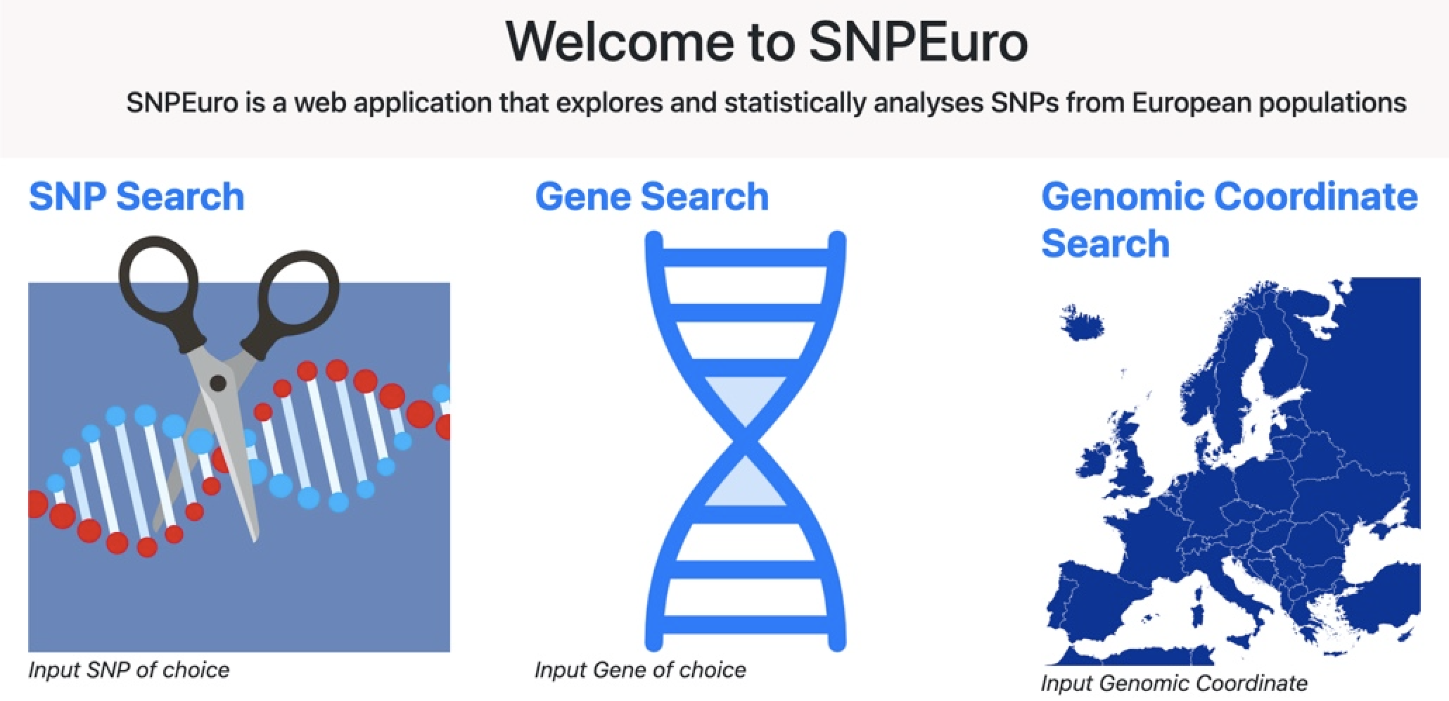
SNPEuro Portal
Web app where SNP information is available relative to European populations;
British, CEPH, Finnish, Iberian & Toscani
Search features are linked to a curated dataset
Information with genotype & allele frequencies provided
Statistical analyses within population for multiple SNPs displayed
Data visualised graphically within sliding windows
SNPEuro Portal
Notes:
SNP Intro – Vi to do?

Slide 5
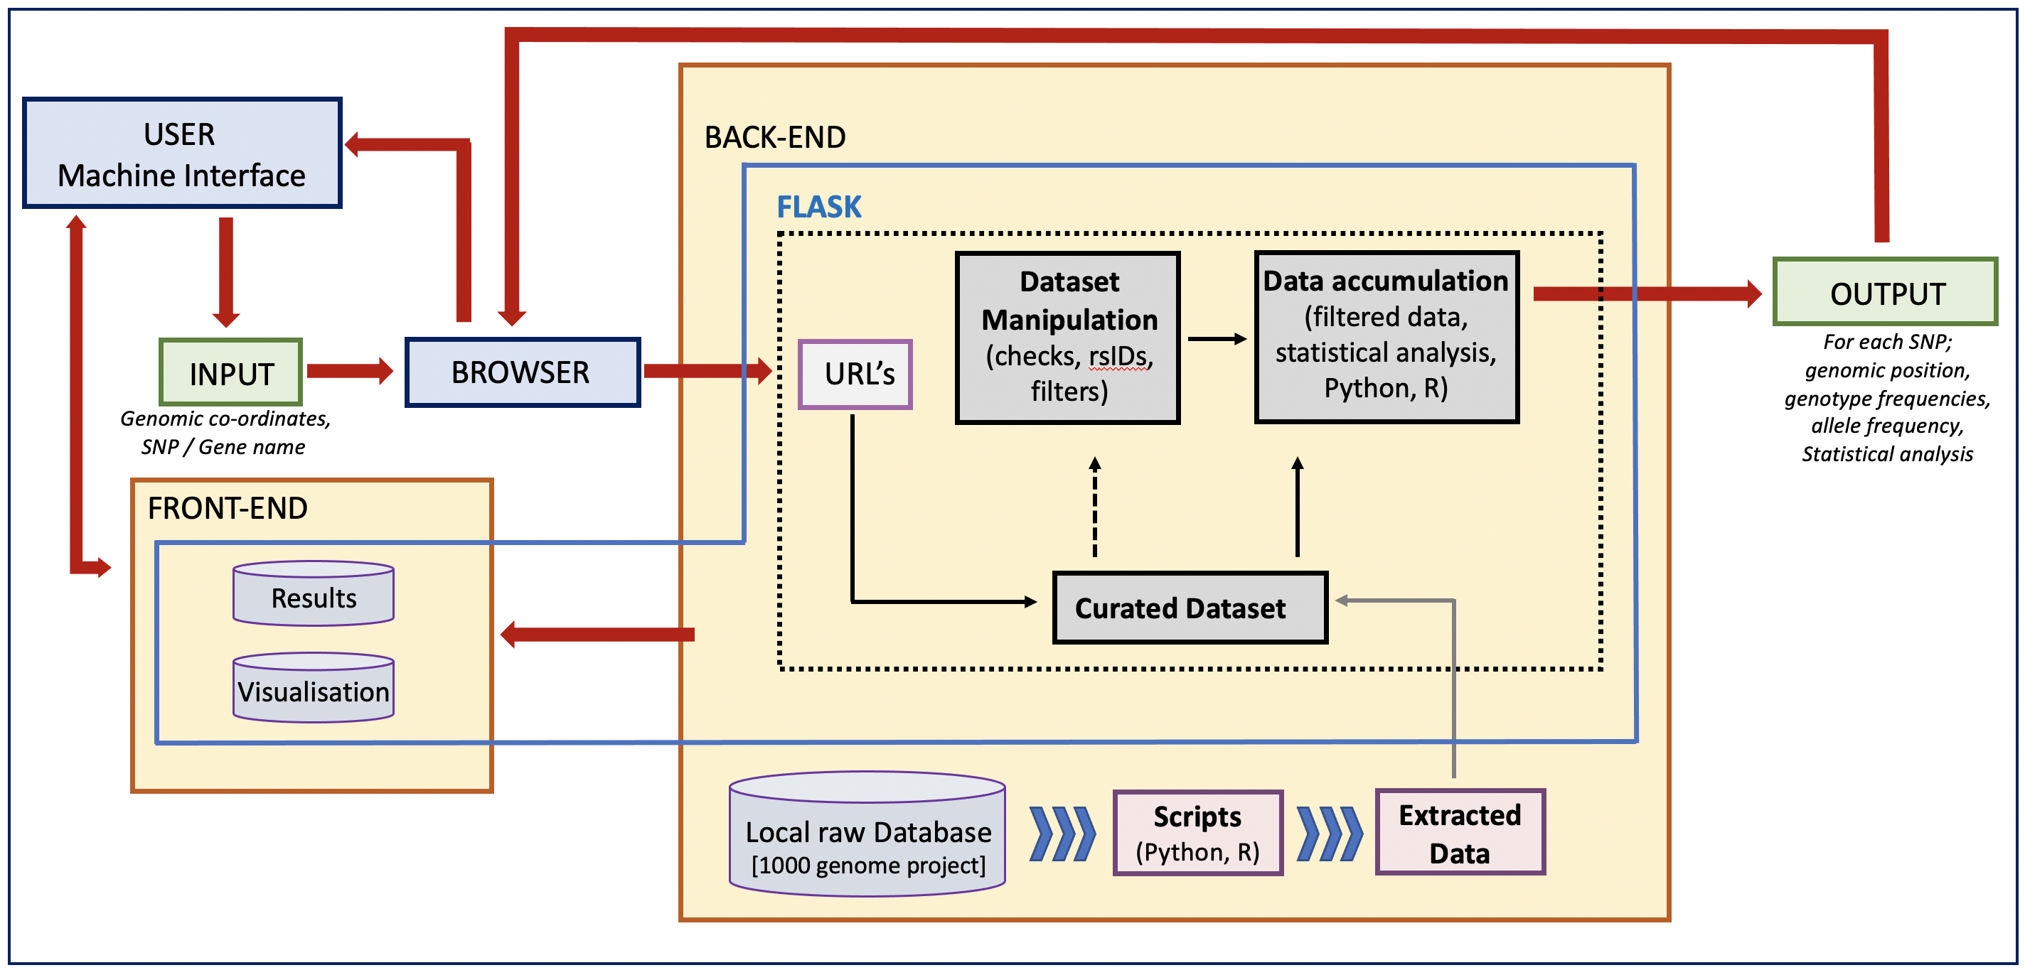
Software Architecture
SNPEuro Portal
Notes:
Data collection and curation, building of the webapp along with statistical analysis to be undertaken with integrative capacity.

Slide 6
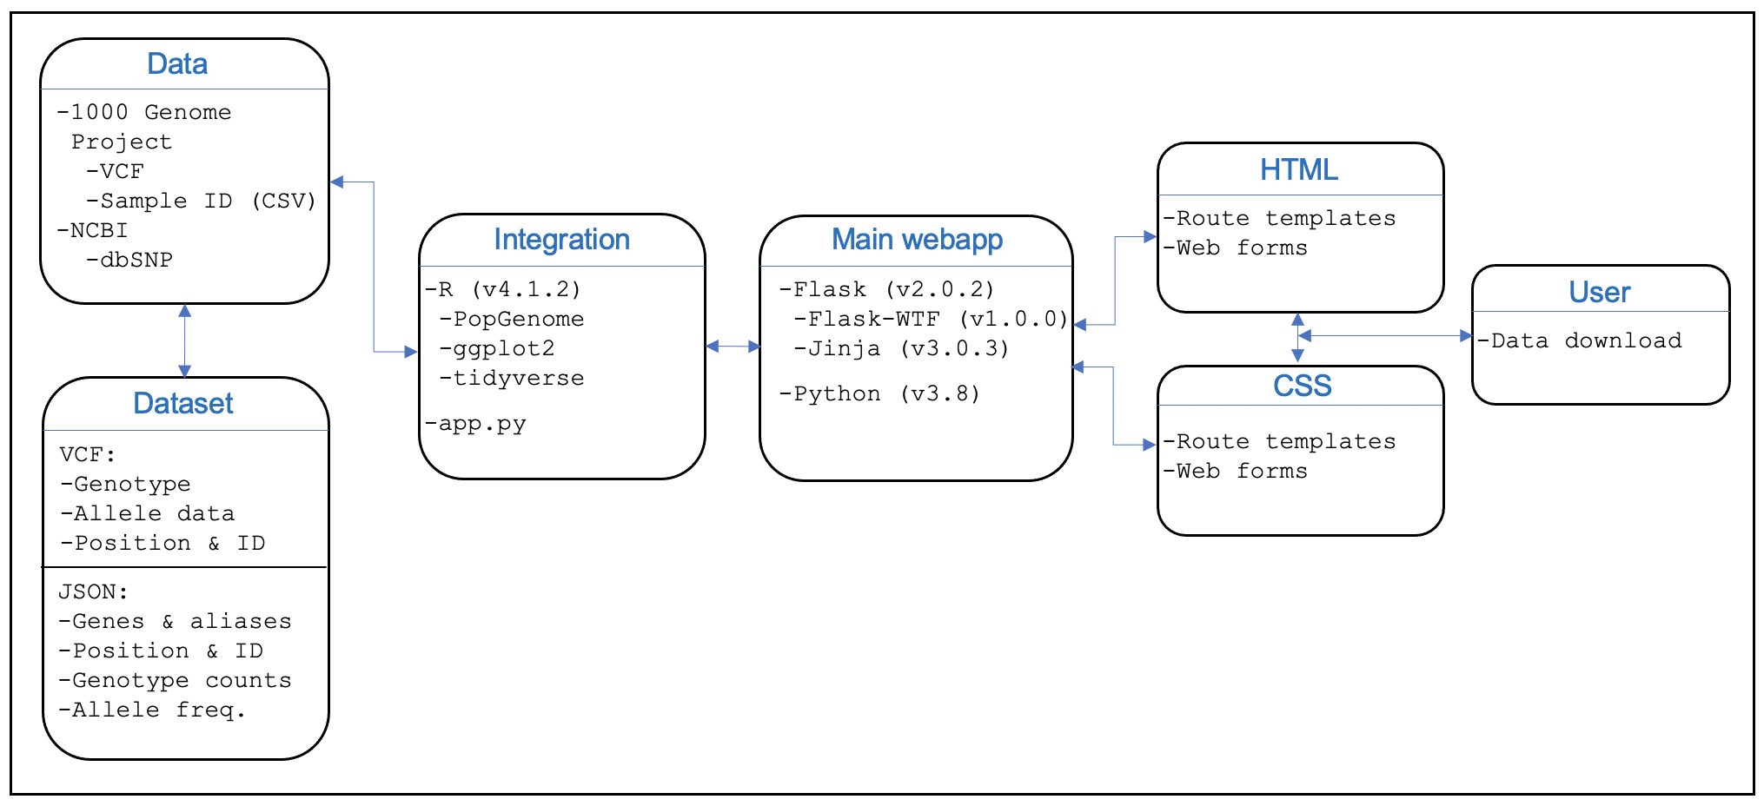
Integration of software components
SNPEuro Portal
Notes:
? Liam to do

Slide 7
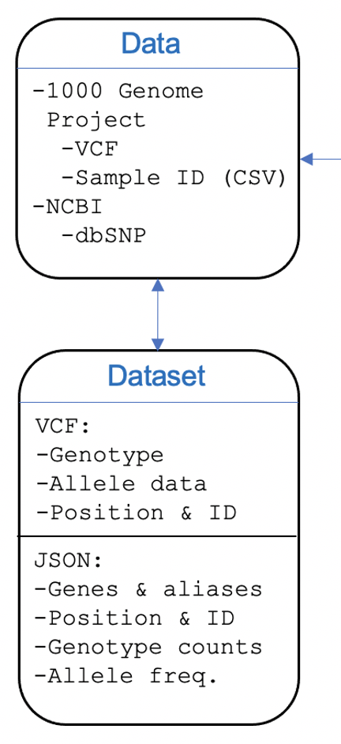
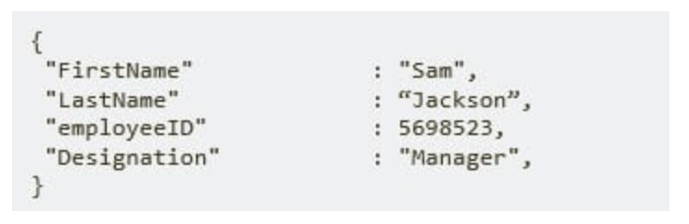
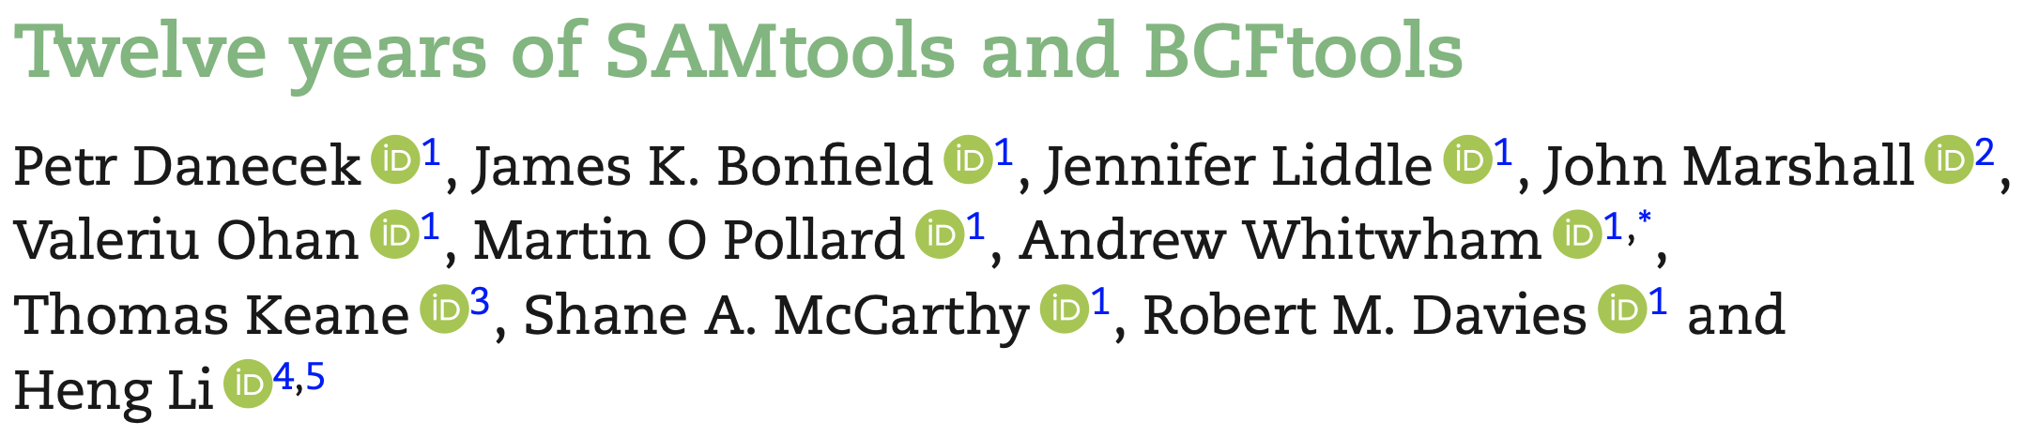

Data extraction & wrangling
Technologies
.JSON format
VCF
JSON
BCFTools
Plink2
easy.entrez
SNPEuro Portal
Notes:
Liam

Slide 8
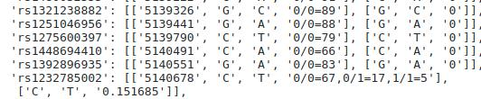
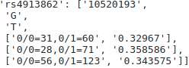
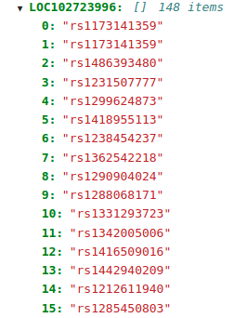
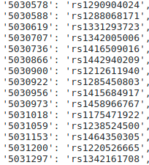
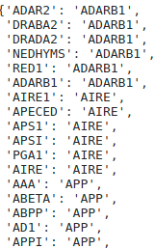
Data curation & manipulation
Allele frequency & Genotype
Data Output
Genes & rsIDs
Positions for rsIDs
Gene Names & Aliases
SNPEuro Portal
Notes:
Liam – will need some additional slides

Slide 9
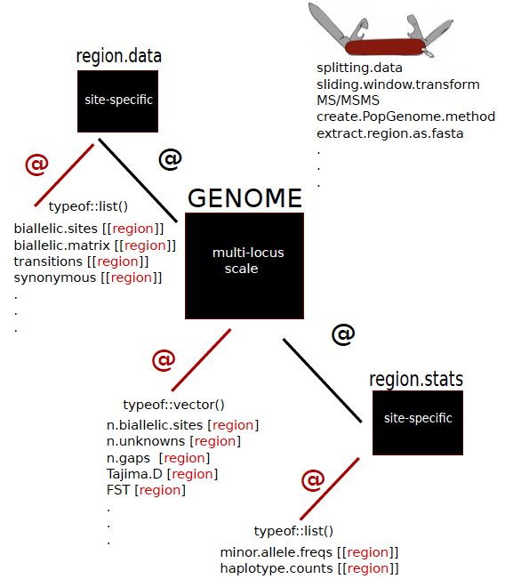
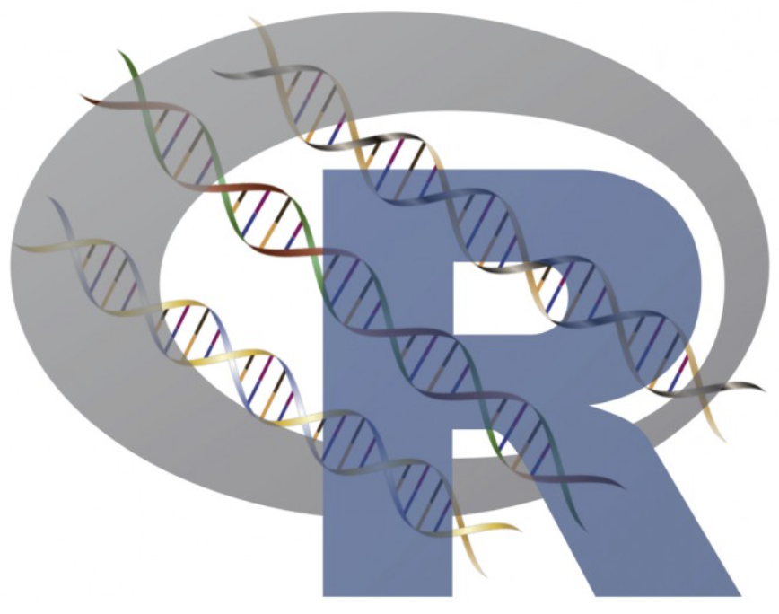

Statistical Tests
PopGenome Package
Rstudio
rpy2 – bridge for R & Python
Package for population genomic analyses
Includes diversity, neutrality and polymorphisms statistics
Applied to whole genome SNP data
SNPEuro Portal
Notes:
I can do this

Slide 10
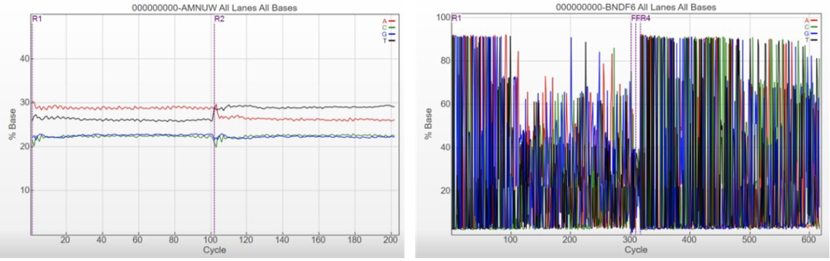
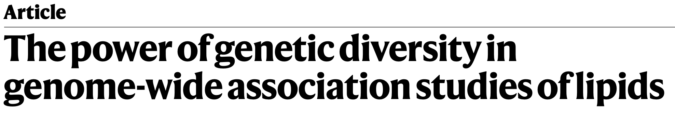
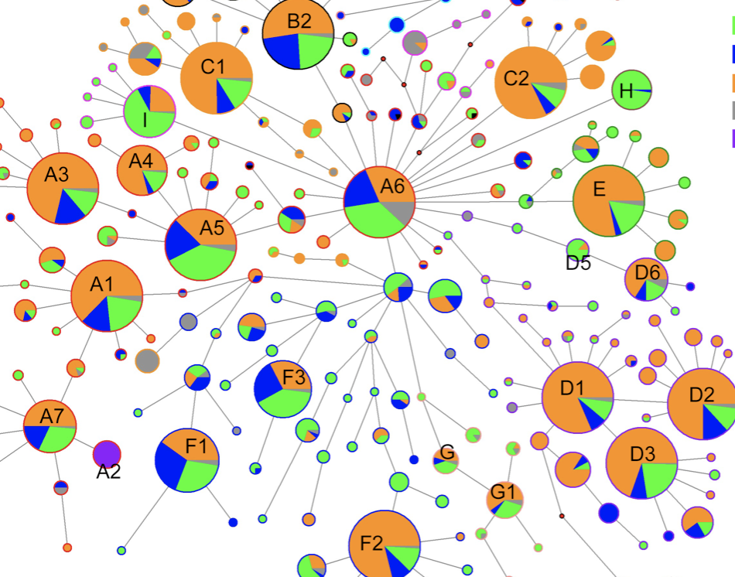

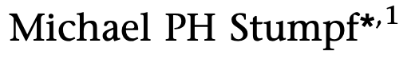
Genetic Diversity Statistics
High Diversity
Low Diversity
Nucleotide Diversity (Pi)
Number of nucleotide differences per site between 2 DNA sequences in pairs in same population
High – equal no.’s of nucleotides; Low – high proportion (variation) of certain nucleotides
Haplotype Diversity
Represents the measure of uniqueness of a particular haplotype in a given population
SNPEuro Portal
Notes:
- Nucleotide diversity is a concept in molecular genetics measuring the degree of polymorphism within a population.
- Nei and Li in 1979 first introduced the measure of nucleotide diversity.
- Average number of nucleotide differences per site between two DNA sequences in all possible pairs within the same population, (this is denoted as Pi)
Often combined with other measures of populations genomics, e.g., haplotype diversity
A haplotype is a set of DNA polymorphisms inherited together and can be a combination of alleles or set of SNPs found on the same chromosome.
Haplotype diversity represents the probability that two randomly sampled alleles are different and can be implicated by a number of different processes
Measure of the uniqueness of a particular haplotype in a given population

Slide 11
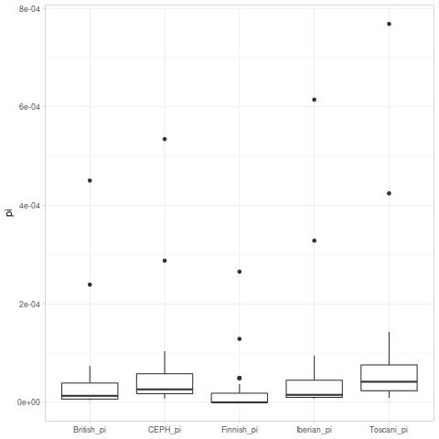
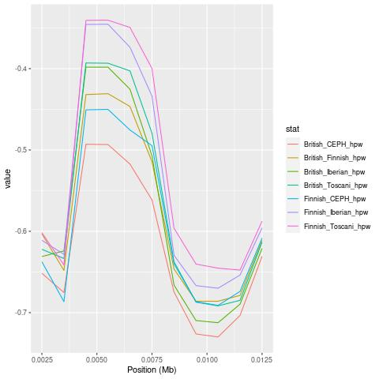
Genetic Diversity Statistics
Nucleotide Diversity (Pi)
Haplotype Diversity
SNPEuro Portal

Slide 12
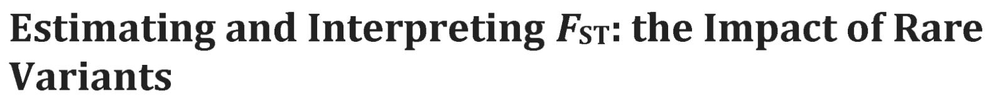
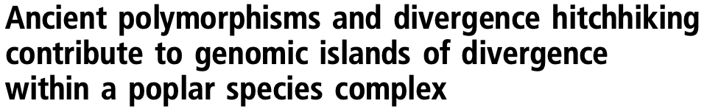
Genetic Differentiation & Divergence
F_{ST} (Genetic differentiation)
Proportion of total genetic variance contained in a subpopulation relative to the total genetic variance
Population selection influences F_{ST} values, such that closely related groups are indistinguishable
d_XY (Divergence)
Within genetic diversity; the absolute nucleotide divergence between two populations
SNPEuro Portal
Notes:
Proportion of the total genetic variance contained in a subpopulation relative to the total genetic variance
Measure of population differentiation due to genetic structure, thus a measure of genetic differentiation and when species diverge in the presence of gene flow¹
Population selection strongly influences F_{ST} values, such that closely related groups are indistinguishable, displaying panmixis
Absolute nucleotide divergence between two populations
This measure showing the patterns of genetic divergence between populations as a function of nucleotide diversity revealing differential gene flow

Slide 13
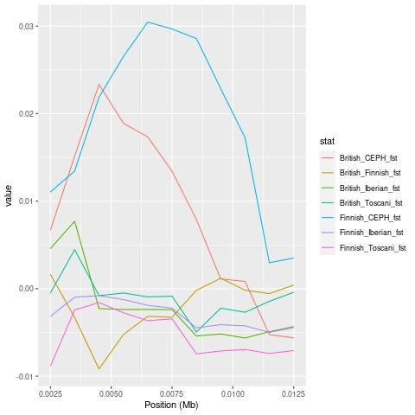
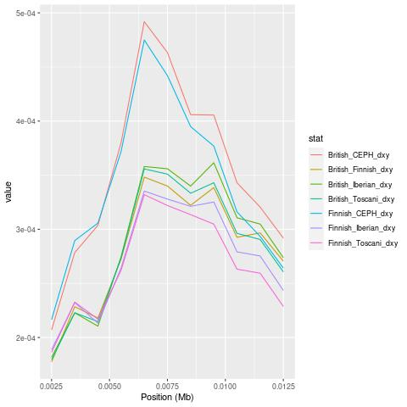
Genetic Differentiation & Divergence
F_{ST} (Genetic differentiation)
d_XY (Divergence)
SNPEuro Portal
Notes:
I can do this

Slide 14
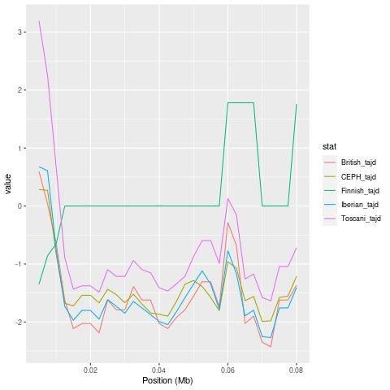

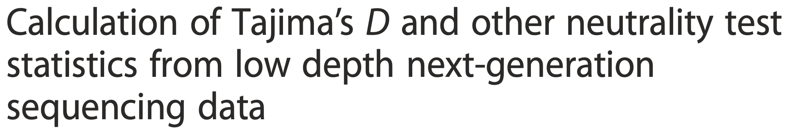
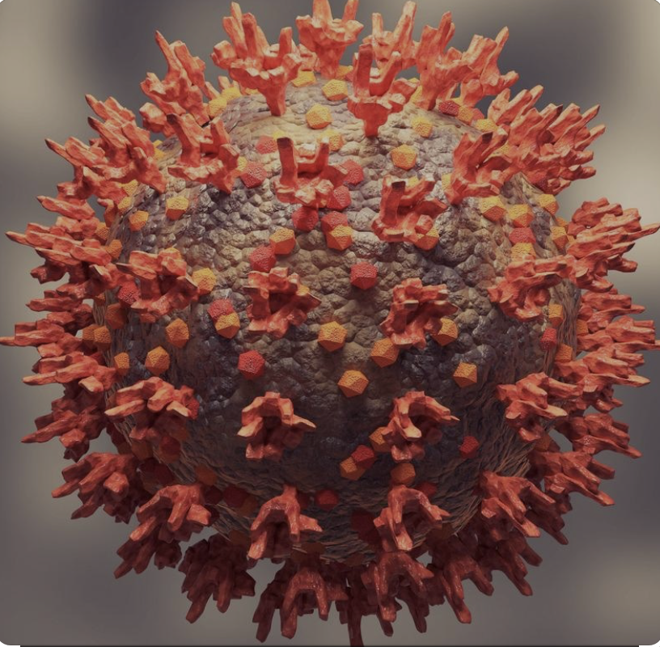

Neutrality
Tajima’s D
The difference between two measures of genetic diversity.
-VE: increase in low frequency polymorphisms relative to expectation (population size expansion).
+VE: decrease in low & high frequency polymorphisms (contraction in population size and/or balancing selection)
SNPEuro Portal

Slide 15
Statistical Analysis – PopGenome (Rstudio Demo)
SNPEuro Portal
Notes:
I can do this

Slide 16
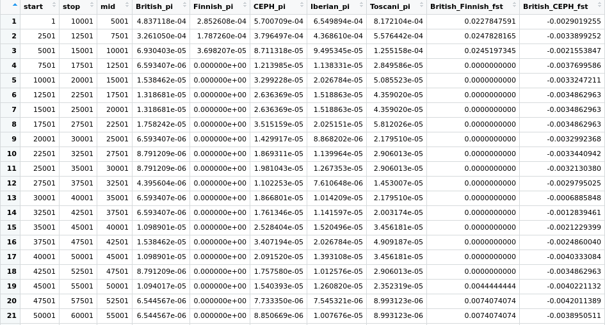
Statistical Analysis – PopGenome
Data frame
SNPEuro Portal
Notes:
I can do this

Slide 17
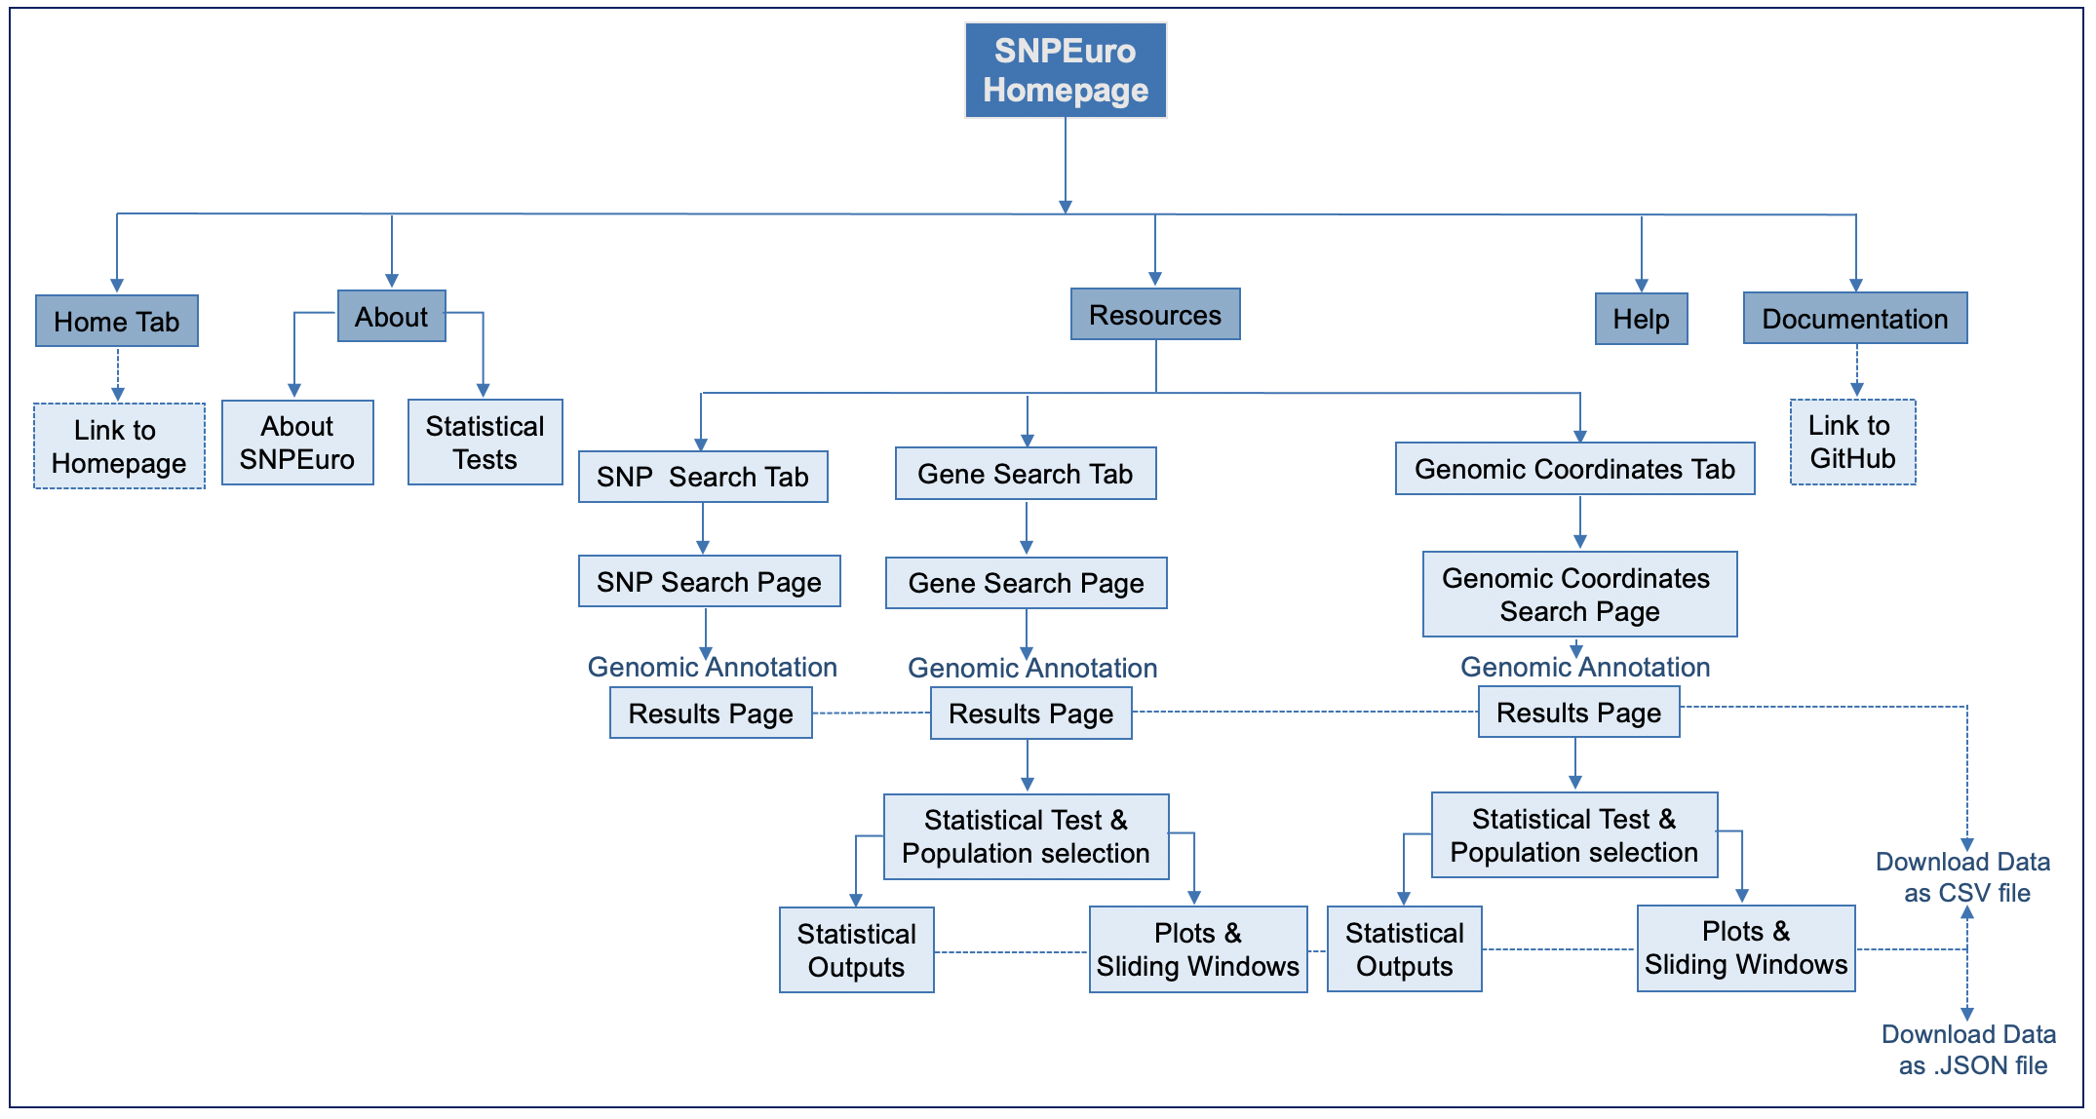
SNPEuro Web app features
SNPEuro Portal
Notes:
Vi

Slide 18
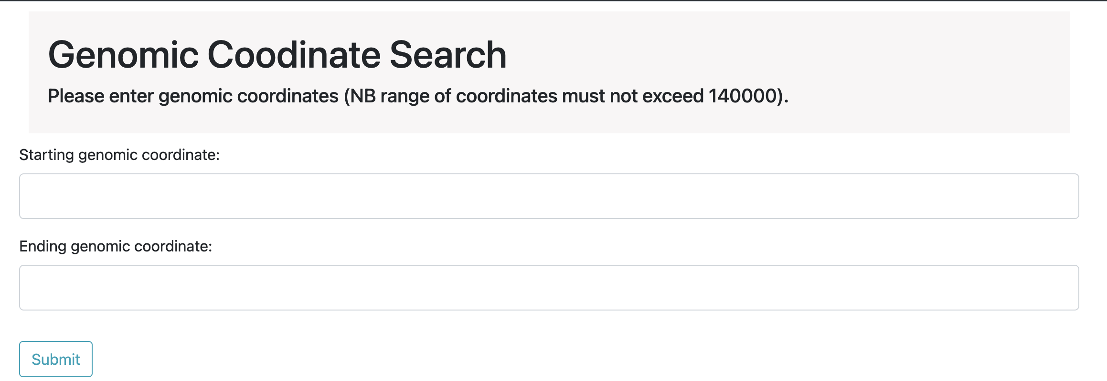
Flask Framework
SNPEuro web app features
SNPEuro Portal
Notes:
Vi

Slide 19
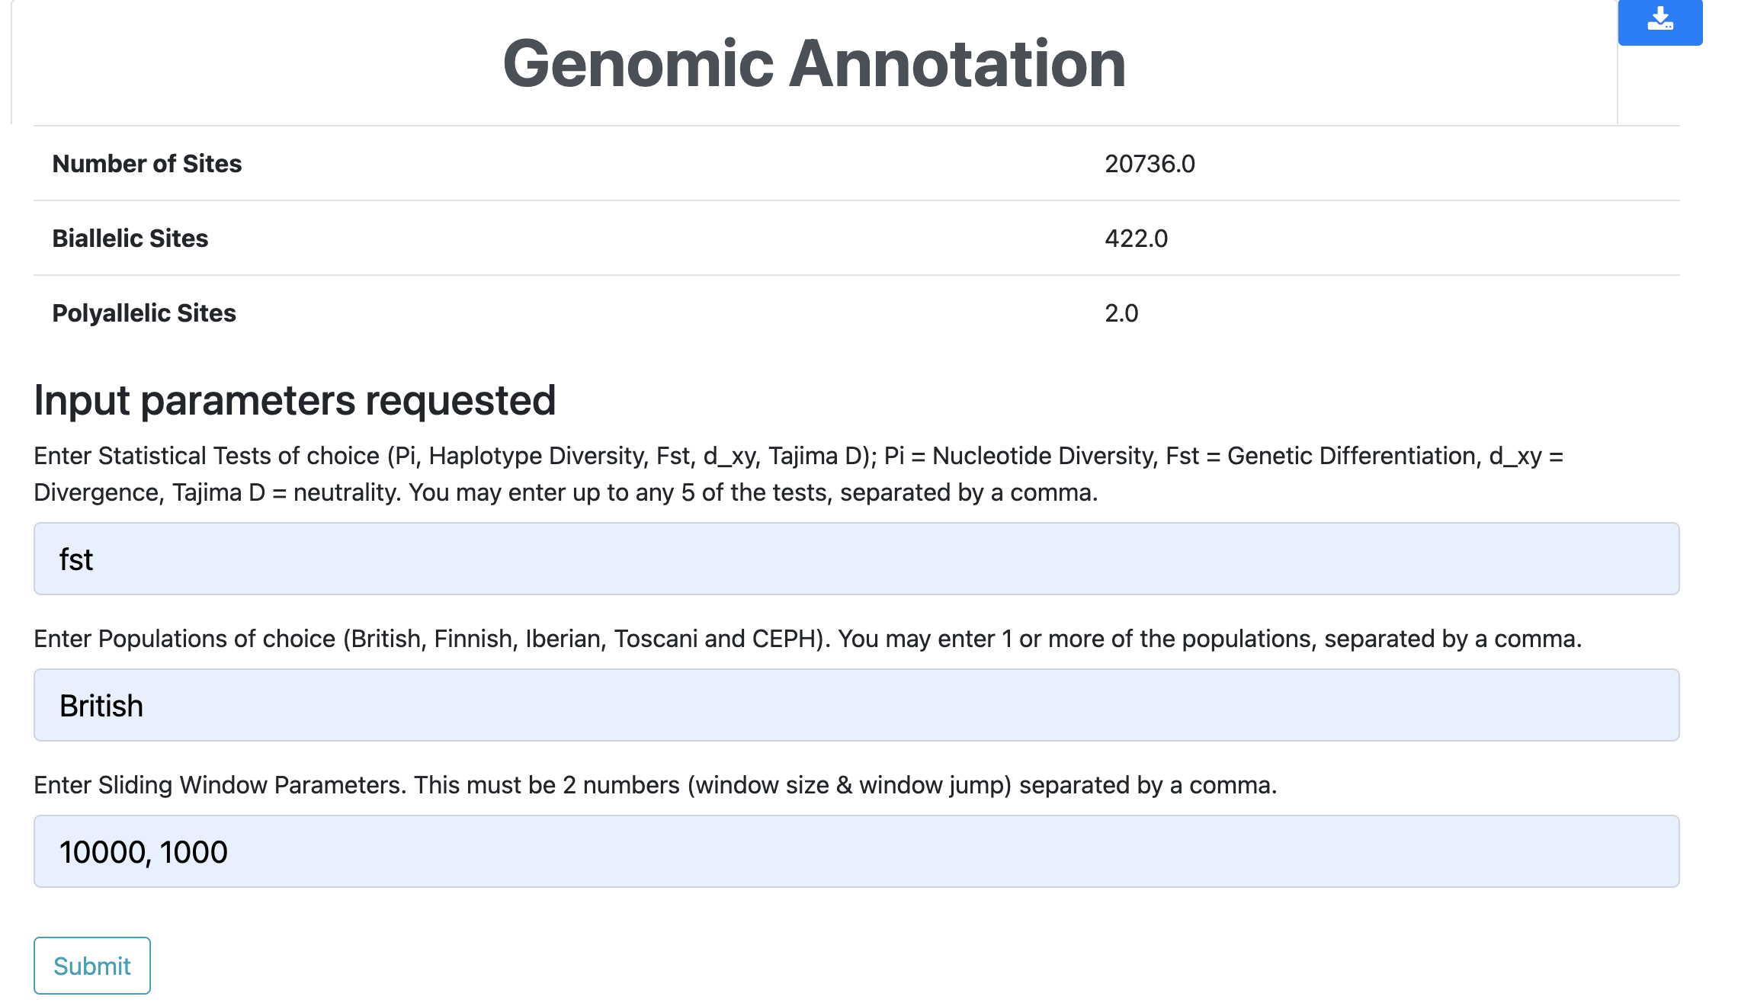
Flask Framework
SNPEuro web app features
SNPEuro Portal
Notes:
Vi

Slide 20
SNPEuro Web app (Demo)
SNPEuro Portal
Notes:
I can do this

Slide 21

Limitations & Future considerations
Large VCFs cannot facilitate some searches – would require truncating
Data packages like SQL could be used – difficult to manipulate data, but simple to query
Plots were stored as JPG files – improvement with plotly & made interactive
Improve aesthetics & functionality of webapp
Improve dataset format and visualisations
Additional search bar for users
SNPEuro Portal
Notes:
Liam

Slide 22


